Slide 1
Assignment 2 SPEECH SEGMENTATION TASK
Simon Chong Kai Yuen - A19EC3028
Clive Lai Yi Cheng - A19EC3019
Ong Yin Ren - A19EC0204
Ng Shu Yu - A19EC3031

Slide 2
Introduction
This assignment requires identifying the drawback of benchmark algorithm in designing an algorithm to segment the sound file accurately.
The given benchmark algorithm yield a less promising result due to it only check the incremental energy value which is crossing the threshold.
We identify the issue and problem, and come out with a modified algorithm that show a much more satisfying result in sound segmentation.

Slide 3
The data set
Dataset used are Set-B And Set-G
This dataset contains 20 sound patterns of connected digit, from 10 male speakers and 10 Female speakers
These files are (0075, 1206, 2433, 3630, 4137, 5580, 6255, 7565, 8299, 9472)
We found that the patterns have the best time tolerance, threshold and window size at 0.1, 1.4 and 250 respectively.

Slide 4
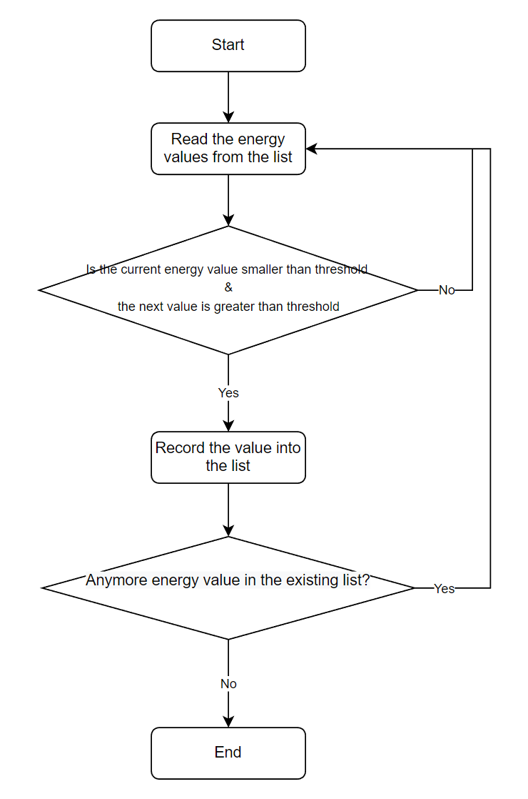
Benchmark
Solution

Slide 5
Issue & Problem of the Benchmark Algorithm
The problem of the benchmark algorithm is it only identifies if the current energy value is smaller than the threshold and the next energy value is greater than the threshold (means incrementally crossing the threshold).
But it does not identify the energy value which is crossing the threshold decrementally by comparing if the current energy value is greater than the threshold and the next energy value is smaller than the threshold.
if (x(m)< Thres) & (x(m+1)>Thres)
S(ind) = m-1;
ind=ind+1;
end

Slide 6
Experimental Setup
Experimental Variable : Time tolerance, Threshold and win size
Time tolerance: t = {0.00, 0.01 0.02, 0.03, 0.04, 0.05, 0.06, 0.07, 0.08, 0.09 0.10}
Threshold : Thres = {1.4, 1.5, 1,6, 1.7, 1.8, 1.9, 2.0, 2.1, 2.2}
Win size : W = {250, 300, 350}
The same set-up is used for the benchmark algorithm.
Comparison between the proposed and benchmark are measure based on
Performance indicator: High match rate, low insertion and omission rate
* The values here are for examples. You may used t heor choose your own that suit your solution

Slide 7
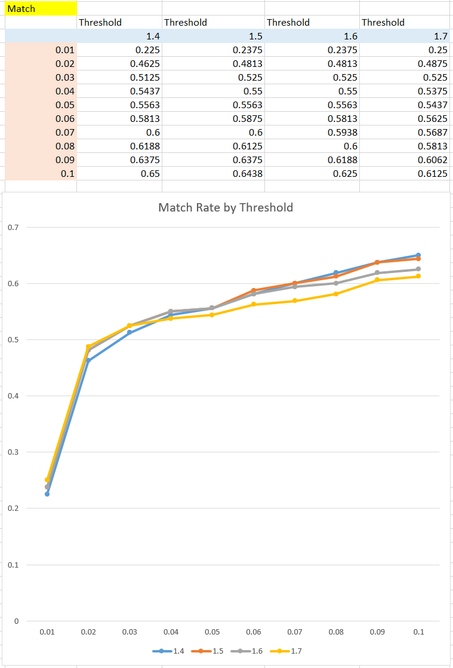
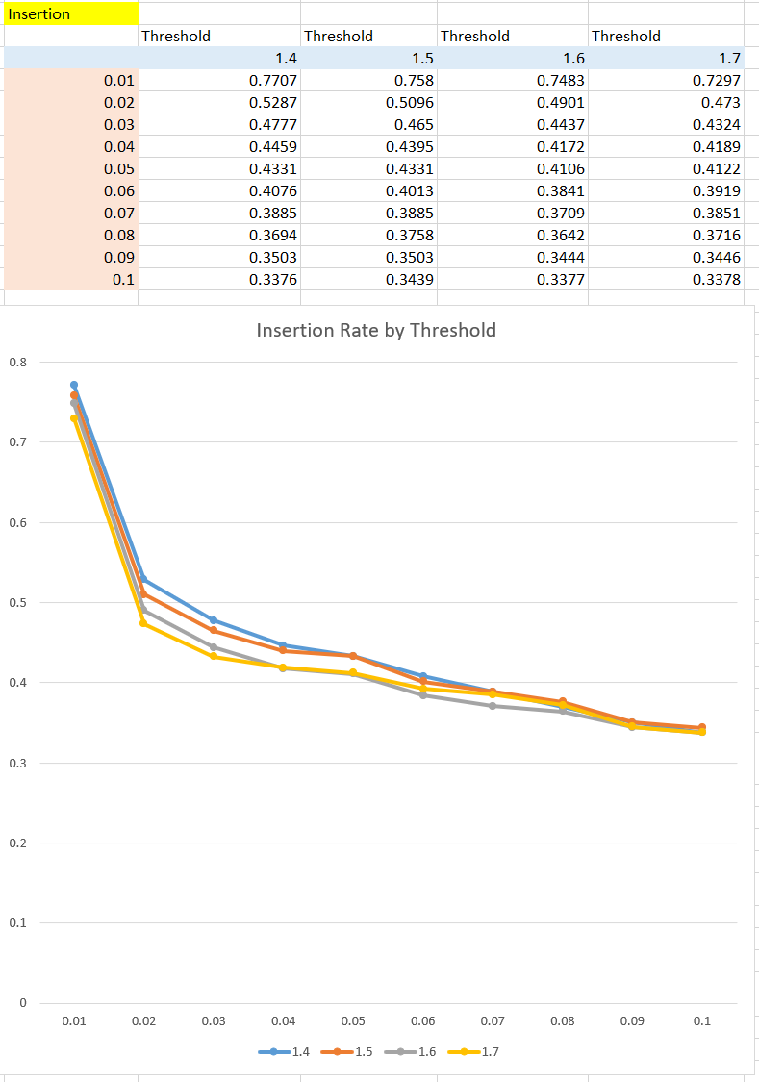
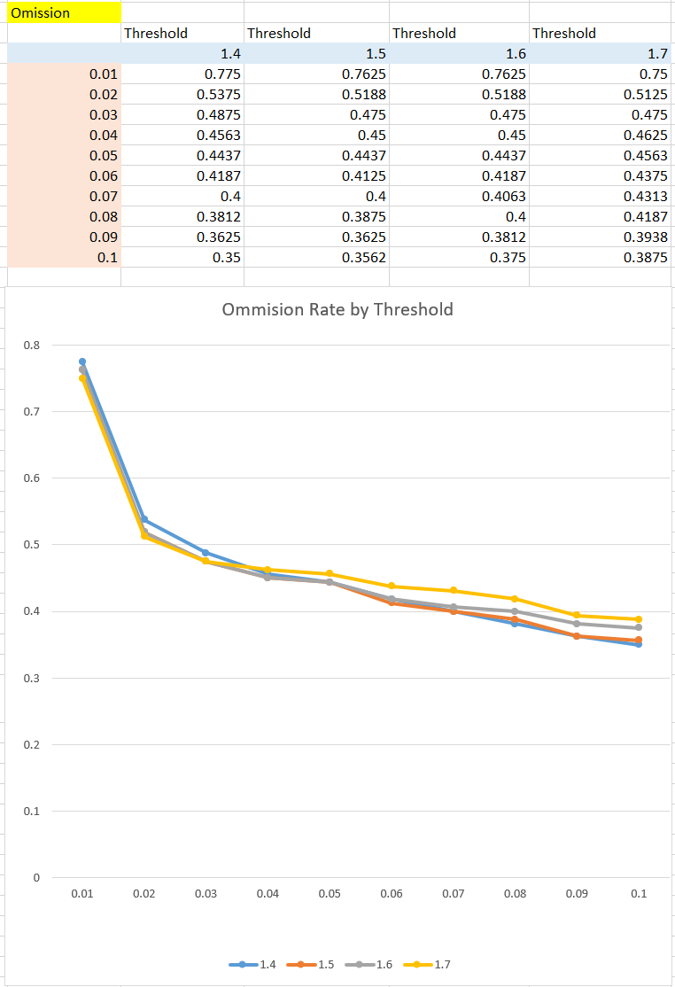
Issues & Problem (continue)
*Testing on different threshold and time tolerance, window size = 250

Slide 8
Issues & Problem (continue)
From the result, we concluded that the best result from these experiment variables:
Time tolerance is 0.1
Threshold is 1.4
Window Size is 250
But…
The highest match rate is only 0.65 (65%), this is quite low from the experiment result for benchmark algorithm 1.

Slide 9
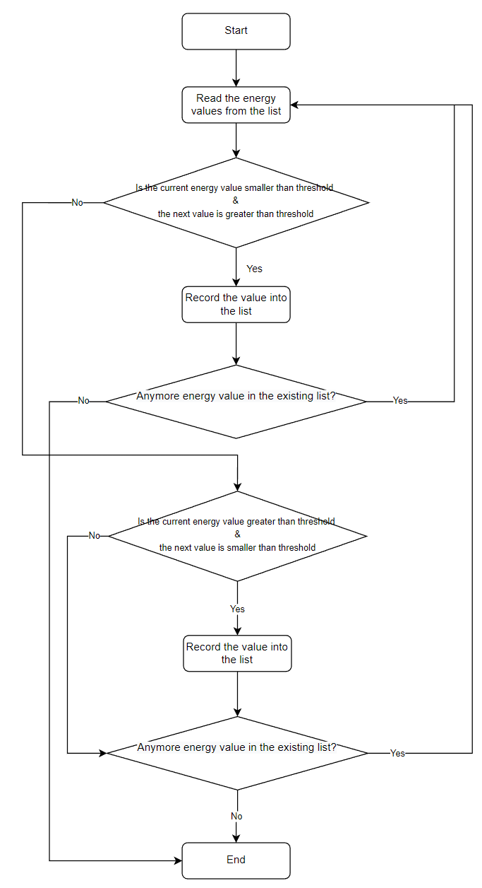
Proposed
Algorithm

Slide 10
Proposed Algorithm
if (x(m)< Thres) && (x(m+1)>Thres)
S(ind) = m-1;
ind=ind+1;
elseif (x(m)> Thres) && (x(m+1)<Thres)
S(ind) = m-1;
ind=ind+1;
end
The proposed algorithm will be identifying the decremental value in the energy form. If the current energy value is not smaller than threshold, and the next energy value is also not greater than threshold (means there is no incrementally crossing the threshold) then the system will check if the current energy value is greater than the threshold and the next energy value is smaller than the threshold (means there is decrementally crossing the threshold).

Slide 11
Experimental Setup
Experimental Variable : Time tolerance, Threshold and win size
Time tolerance: t = {0.00, 0.01 0.02, 0.03, 0.04, 0.05, 0.06, 0.07, 0.08, 0.09 0.10}
Threshold : Thres = {1.4}
Win size : W = {250}
The same set-up is used for the benchmark algorithm.
Comparison between the proposed and benchmark are measure based on
Performance indicator: High match rate, low insertion and omission rate
* The values here are for examples. You may used t heor choose your own that suit your solution

Slide 12
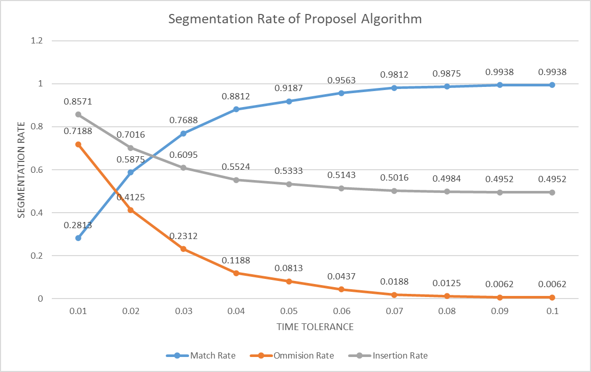
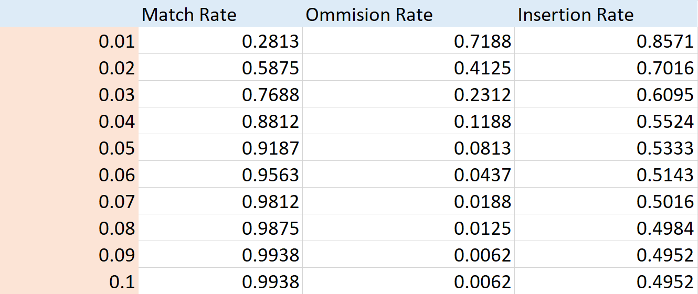
Results
Testing with:
Time tolerance = 0.1
Threshold = 1.4
Window Size = 250

Slide 13
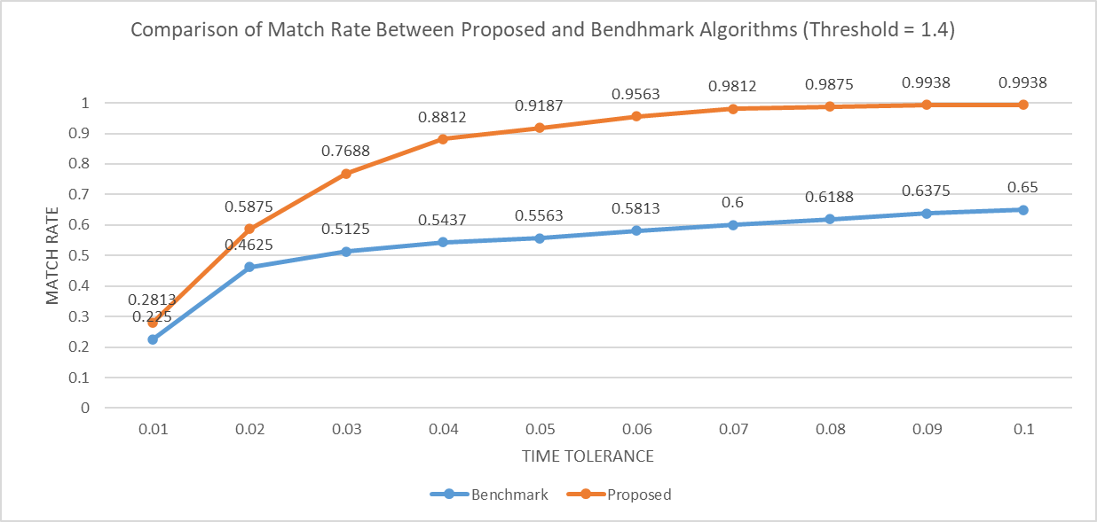
Results

Slide 14
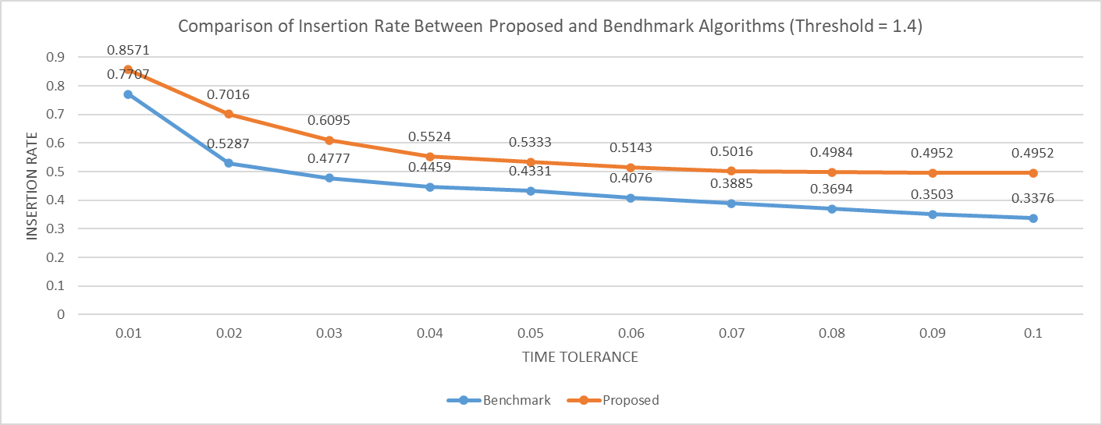
Results

Slide 15
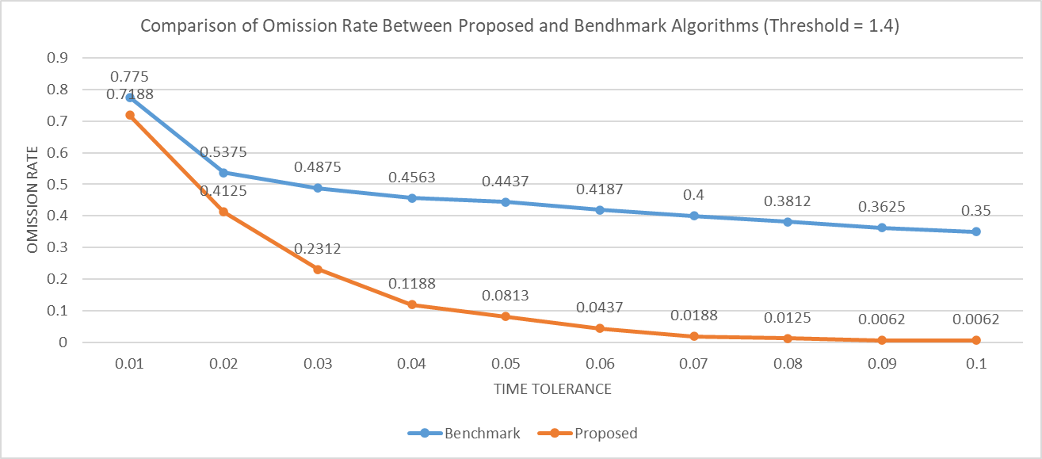
Results

Slide 16
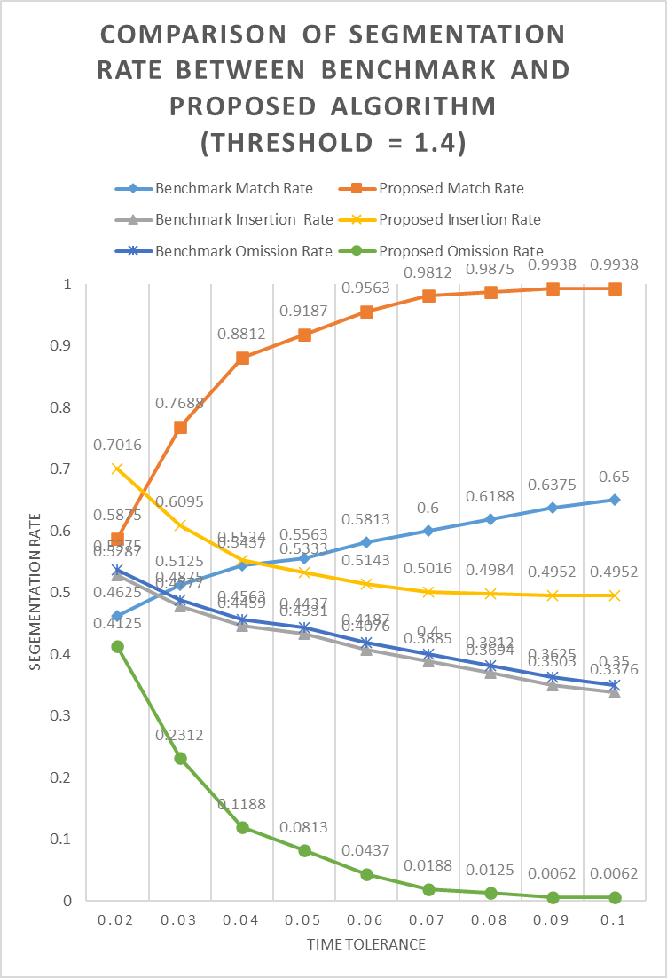
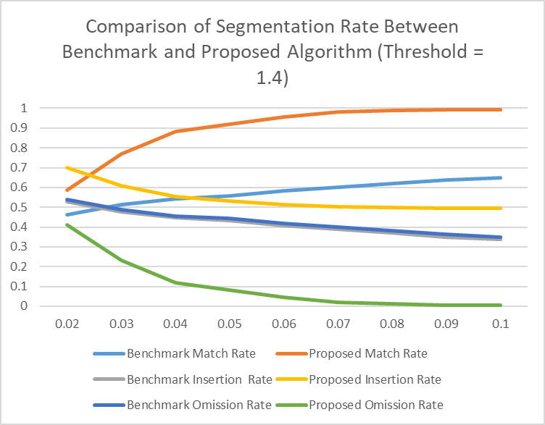
Results
General View
Detail View

Slide 17
Conclusion
The best tolerance rate is 0.1, threshold is 1.4 and the window size is 250.
The benchmark algorithm is only checking the incremental between the threshold.
The proposed algorithm check both incremental and decremental between the threshold.
Although the insertion rate for proposed algorithm is slightly higher than the benchmark algorithm, but we think it is alright because it is not much different.

